Slide 1

INFO-6068 Capstone Project
- Final Presentation
- Team pixel
Presenters Rutvik Patel : 1220039
Sakshi Modi : 1179590
Parth Patel : 1229403
Vijul Vyas : 1227571
Notes:
Entered text
Slide 3: Introduction
Purpose: Outline the approach to ensure quality and reliability of software products.
Goals:
Maintain consistency
Improve efficiency
Achieve excellence in testing
Slide 4: Objectives
Key Objectives:
Ensure functionality, reliability, and usability
Identify and resolve bugs
Deliver a robust platform meeting user needs
Slide 5: Scope
Key Aspects:
Development of a comprehensive test plan
Definition of a tailored test approach
Testing across multiple stages
Verification of all five modules: Administrator, System Functions, Data Management, User Interfaces, and Reporting
Entered text
Slide 6: Roles and Responsibilities
Team Roles:
Project Manager (Rutvik Patel): Coordinate team, develop test plan, oversee testing
Scribe (Sakshi Modi): Document testing activities, track plans and results
Developer (Vijul Vyas): Resolve bugs, optimize application performance
Tester (Parth Patel): Execute test cases, report issues
Slide 7: Testing Overview
Test Lifecycle Stages:
Requirement Analysis
Test Planning
Test Case Development
Environment Setup
Test Execution
Test Cycle Closure
Slide 8: Test Approach
Methodology: Agile Testing
Advantages:
Flexibility to adapt to new requirements
Continuous communication through daily scrums
Regular reviews for continuous improvement
Slide 9: Test Standards
Severity Levels:
Critical (S3): System unusable, regulatory violations
High (S2): Significant impact on functionality
Medium (S1): Moderate impact, specific features affected
Low (S0): Minimal impact, minor issues
Slide 10: Test Stages
Types of Testing:
Functional
Non-Functional
Business Processes
Volume
Performance
Security
Usability
Interface Tests
Slide 11: Reviews and Inspections
Review Process:
Planning, Preparation, Review Meeting, Rework, Follow-Up
Inspections:
Formal, rigorous, structured defect identification
Walkthroughs:
Informal, interactive feedback sessions
Slide 12: Test Documentation
Key Documents:
Test Strategy
Test Plans
Test Specifications
Test Cases
Test Scripts
Test Reports
Slide 13: Test Execution
Objectives:
Validate quality, functionality, performance, and reliability
Pre-requisites:
Test Environment Setup, Test Data Preparation, Test Cases Review
Tools and Resources:
JIRA, TestRail, Bugzilla, Selenium, QTP, JMeter, LoadRunner
Slide 14: Escalation and Roles
Issue Escalation:
Prompt logging in JIRA, structured escalation process, close collaboration with developers
Roles:
Project Manager: Monitor progress, manage escalations
Team Members: Execute tests, provide updates
Slide 15: Conclusion
Summary:
Comprehensive strategy to ensure software quality
Focus on adaptability, thorough testing, and effective issue resolution
Slide 16: Q&A
Title: Questions and Answers
Subtitle: Thank you for your attention!

Slide 2
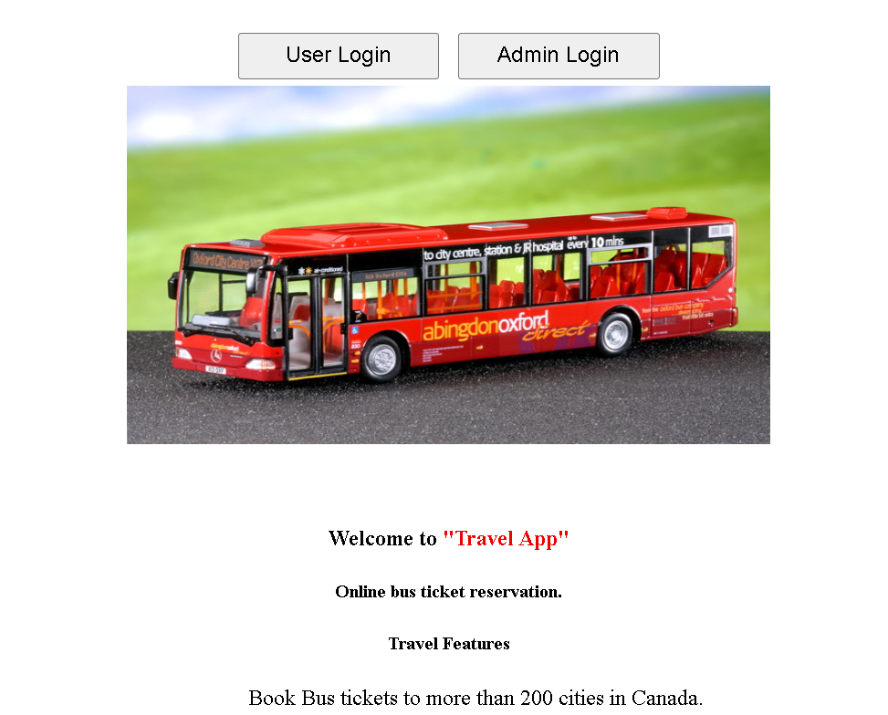
Introduction
TravelApp is a comprehensive travel management platform that simplifies trip planning, booking, and itinerary tracking. With user-friendly features and real-time updates, it ensures a seamless travel experience from start to finish.
User Module
View Routes
Book tickets
Cancel ticket
Give feedback
View feedback
Admin Module
Add route
Add Travel
View Travel
View Route
Delete Routes
Delete Travel

Slide 3

Milestone Achieved
Milestone 1: Test Strategy, May 26th May
Milestone 2: Test Plan & MS Project, June 9th
Milestone 3: Test Scenarios, Use Cases, June 30th
Milestone 4: Test Cases/Scripts, July 14th
Activity: Test Execution Reporting, July 21st
Milestone 5: Execution Report, August 4th
Milestone 6: Final Presentation & Project Closure - Aug 11th

Slide 4

Documents Created
Test Strategy
Test Plan & MS Project
Test Scenarios, Use Cases
Test Cases/Scripts
Execution Report
Final Presentation
IAD logs
Weekly Status Report
Meeting Minutes
Meeting Agenda

Slide 5

Type of Testing performed
Functional
Unit testing
Unit integration testing
System testing
System integration testing
Non-functional
Performance
Security

Slide 6
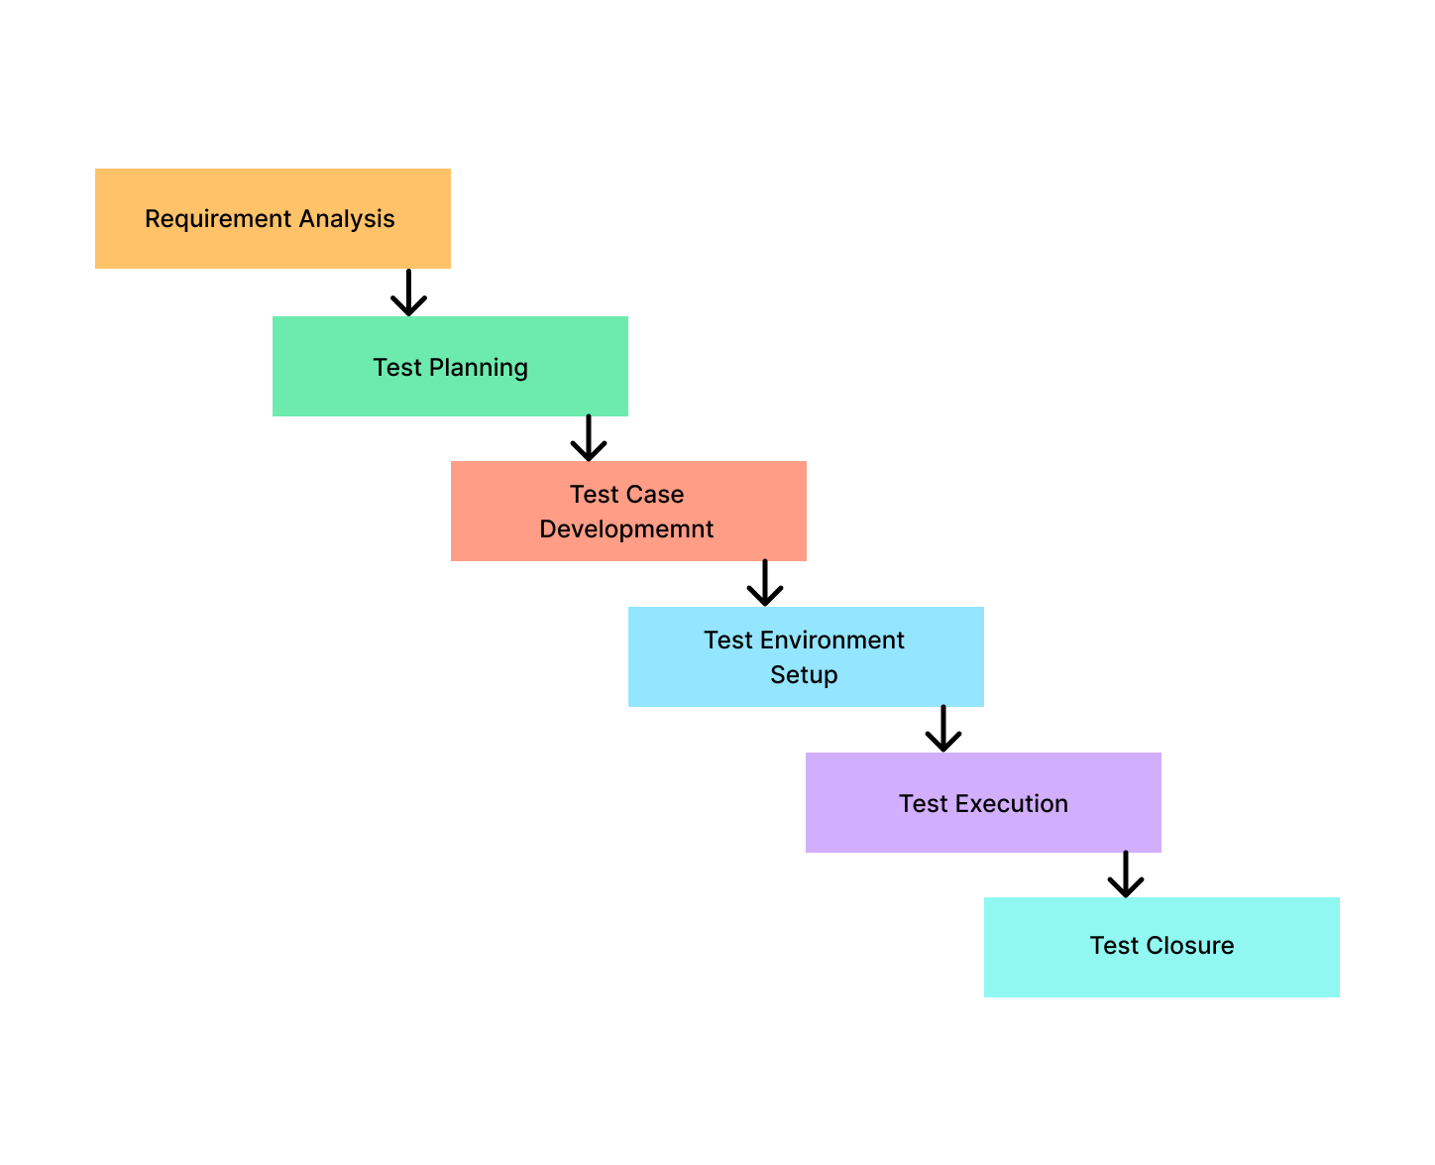
STLC

Slide 7

Tools & Technology Specification Technology:- TestNG Maven Selenium Java
Tools:-
Eclipse
Chrome
JIRA
Laptop

Slide 8
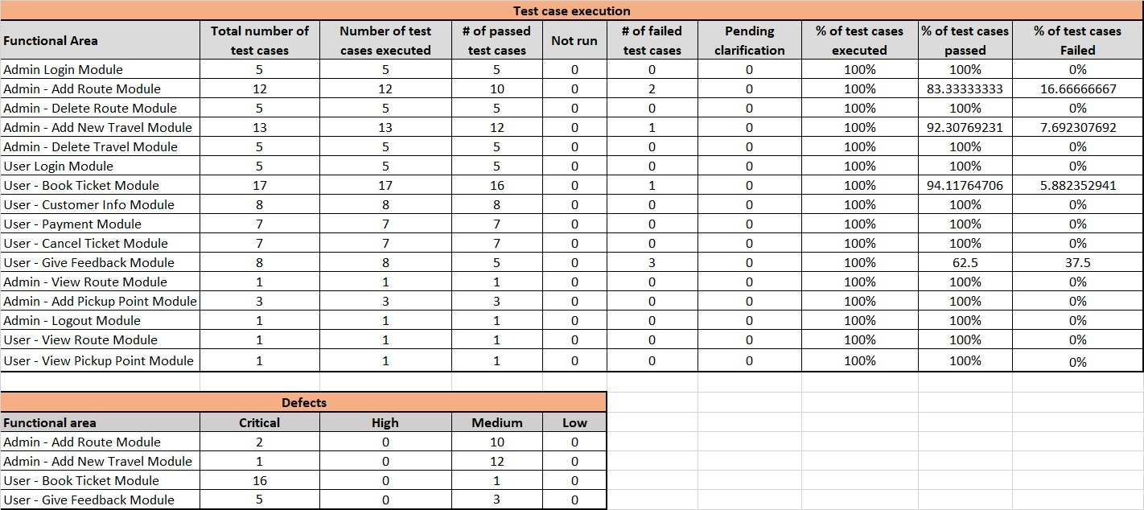
Defect Report

Slide 9
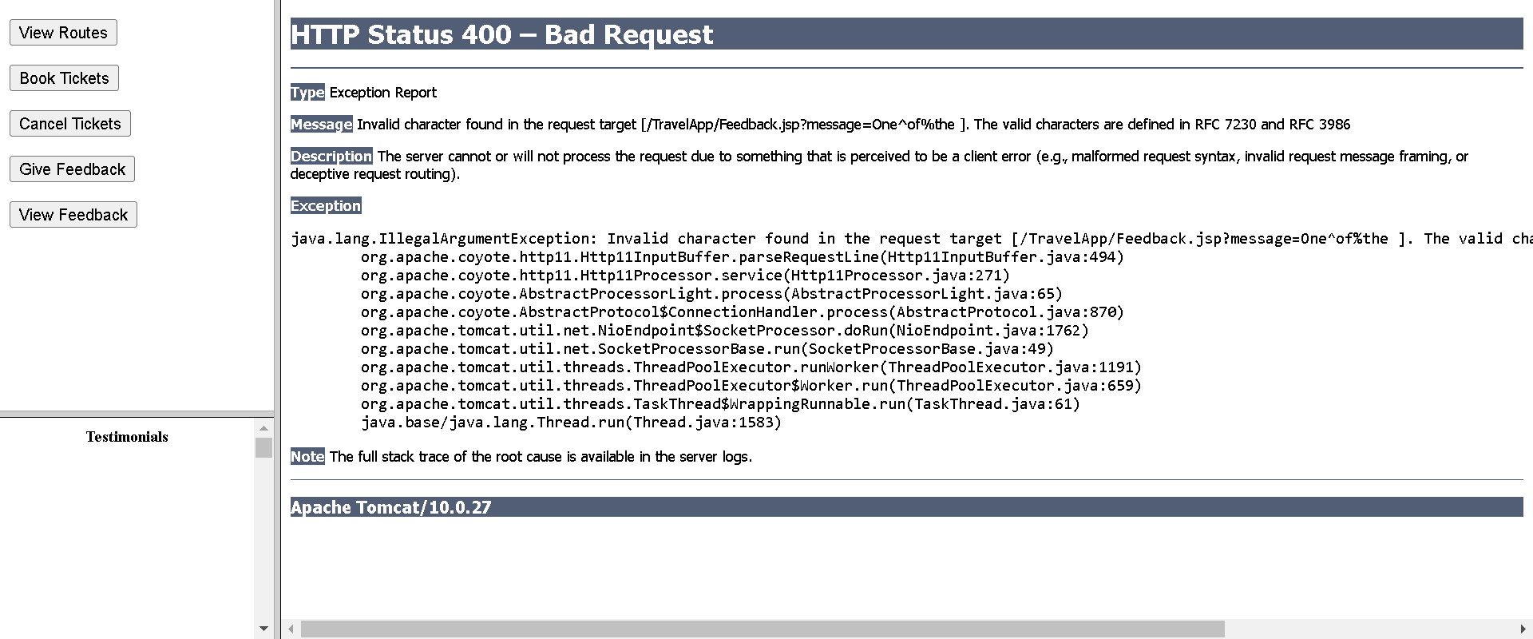
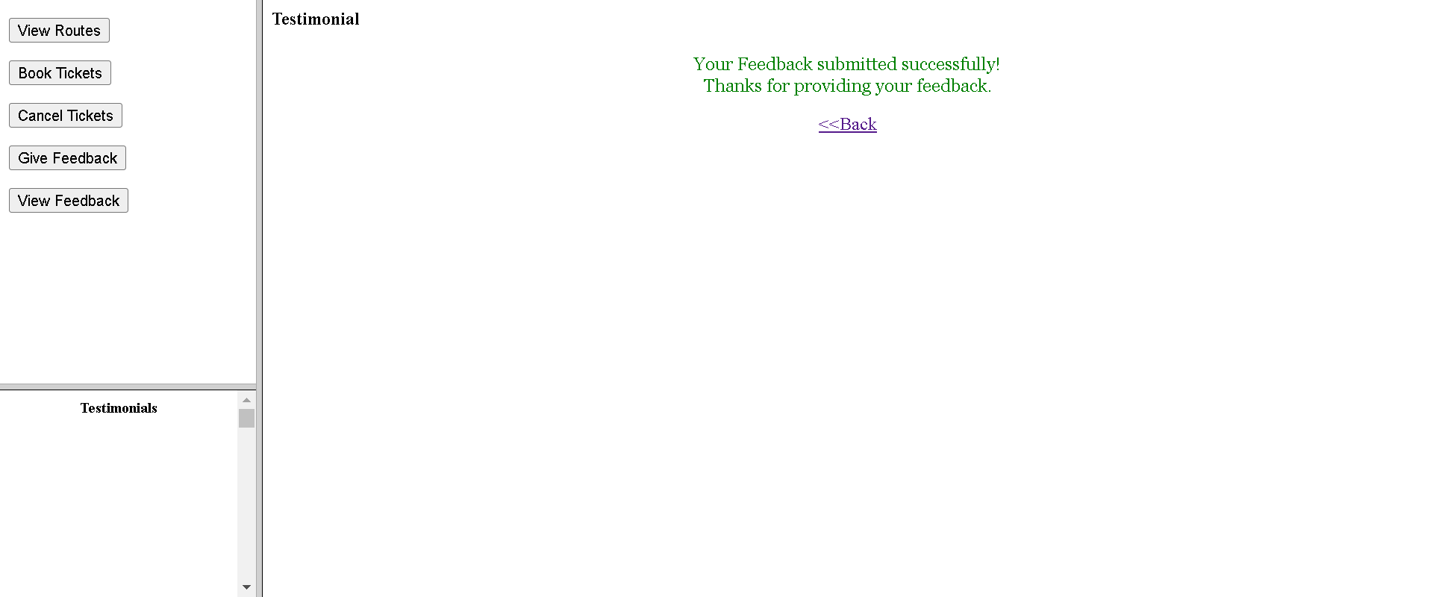
Screenshot Of Execution

Slide 10
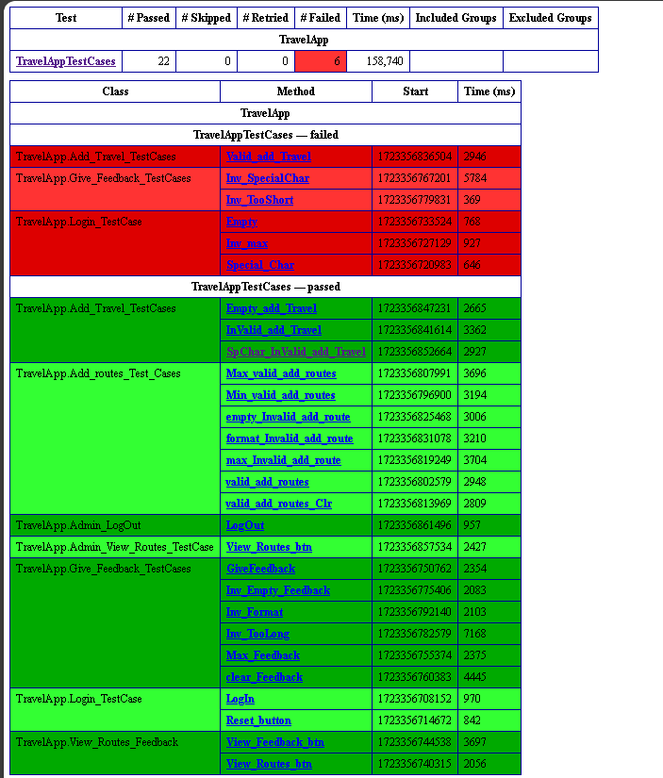
TestNG execution report

Slide 11
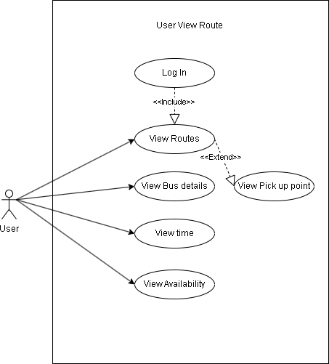
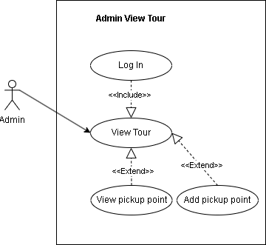
Use Cases

Slide 12

Entry & Exit Criteria
Entry Criteria
Requirements and test plan approved.
Stable build and environment set up.
Automation scripts and tools ready.
Test data prepared.
Access and permissions granted.
Exit Criteria
All tests executed and passed.
Critical defects resolved.
Required coverage achieved.
Performance benchmarks met.
Stakeholder sign-off obtained.

Slide 13

Final recommendation and lesson learned
Final Project Summary:
Web Application: Travel App is designed for travel bookings and itinerary management.
User-Friendly Interface: Focus on simplifying interactions for planning trips.
Core Functionalities Tested: Automated testing included user authentication, booking management, and payment processing.
Automation Benefits: Early bug identification led to a smoother release.
Lessons Learned:
Early Integration of Automated Testing: Critical for catching and resolving issues earlier in the development cycle.
Efficiency: Early testing saved time and resources, contributing to a more efficient project workflow.

Slide 14


Slide 15

Lets move to execution part →

